Slide 1






Bootcamp
The World of IT 2
Basic Level
CAROLINA GOMEZ MELENDEZ
May 23rd, 2024

Slide 2
Table of content
1
Review
2
Prefixes and Suffixes
3
Practice- Homework

Slide 3
What did we learn about last class?
Vocabulary
Review
Determiners and Pronouns
https://es.educaplay.com/recursos-educativos/19001768-vocabulary.html
https://www.liveworksheets.com/node/5607466
Notes:
Verbs in past review: https://wordwall.net/es/resource/34704781/crossword-past-simple-verbs

Slide 4


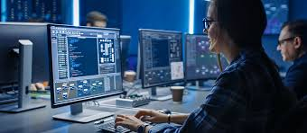
WARM-UP
Watch the video “Master the Digital Lingo: Understanding Prefixes and Suffixes in Information Technology”.
https://www.youtube.com/watch?v=g25lNPD_Jxsl

Slide 5
Video quiz
After watching in the warming up session, answer the questions.
https://es.educaplay.com/recursos-educativos/19052982-prefixes_and_suffixes.html

Slide 6

Prefixes
A prefix is a word part we add to the beginning of a word. Prefixes change the meaning of the base word. For example, the prefix un- can mean "not," "remove," or "opposite." Adding un- to the word "happy" gives you the word "unhappy," which means not happy.
Un and re are the two most common prefixes in the English language. Re- means "again" or "back," such as in the words "rethink" "redo" and "repay."

Slide 7
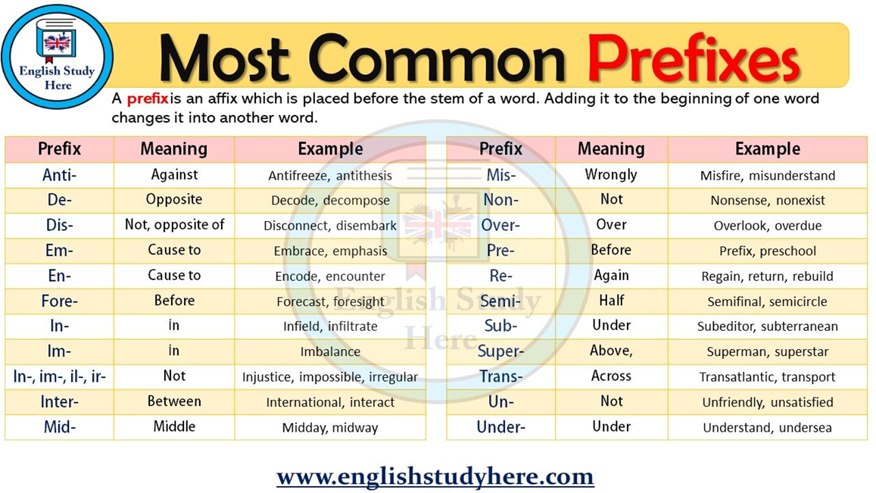
Notes:
Verbs in past review: https://wordwall.net/es/resource/34704781/crossword-past-simple-verbs

Slide 8
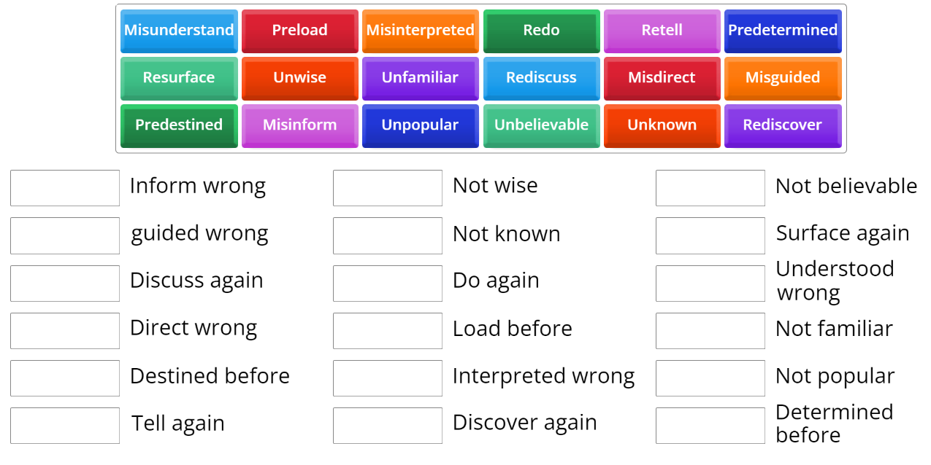
Practice 1ª: match the words to their corresponding
Meaning.
https://wordwall.net/es/resource/11615133/prefixes
Notes:
Identify words that have prefixes and suffixes: https://docs.google.com/document/d/1zRDRXCCWAltDi3bqArSwWsT0ufKNP5m-/edit?usp=sharing&ouid=107132437745420382364&rtpof=true&sd=true
Reading:

Slide 9
Practice 1B READING ACTIVITY
In the dynamic world of information technology (IT), innovations and advancements occur at an exponential rate, driving global transformation across all sectors. This vast domain encompasses a multitude of disciplines such as artificial intelligence (AI), cybersecurity, data analytics, and network infrastructure, each playing a pivotal role in the digital age.
Understanding the intricacies of IT requires familiarity with common prefixes that elucidate various aspects of technology. For instance, 'cyber-' denotes matters related to computers or computer networks, as seen in terms like cybersecurity and cyberspace.
Similarly, 'inter-' emphasizes connections or interactions between systems, exemplified by the internet and interconnectivity. The prefix 'multi-' indicates multiple elements, evident in multitasking and multimedia, highlighting the multifaceted nature of modern technology. 'Auto-' signifies automation, a key concept in autonomous systems and automated processes that enhance efficiency and productivity.
'Bio-' combines biology with technology, birthing fields such as bioinformatics and biotechnology. 'Tele-' is used for long-distance communications, illustrated by telecommunications and teleconferencing, which bridge geographical gaps.
Notes:
Identify words that have prefixes and suffixes: https://docs.google.com/document/d/1zRDRXCCWAltDi3bqArSwWsT0ufKNP5m-/edit?usp=sharing&ouid=107132437745420382364&rtpof=true&sd=true
Reading:

Slide 10
Practice 1B READING ACTIVITY
Additionally, 'hyper-' suggests an above-normal state, as in hypertext and hypermedia, which offer enhanced interactive experiences. 'Micro-' points to small-scale technology, central to microprocessors and microcontrollers, essential for compact and efficient electronic devices. 'Nano-' delves into nanotechnology, manipulating matter at the atomic level to create innovative materials and devices.
Understanding these prefixes aids in navigating the ever-evolving IT landscape, where digitalization, connectivity, and innovation reign supreme. The synergy of these elements propels society toward a future where technology seamlessly integrates with daily life, transforming how we live, work, and communicate. As IT continues to evolve, mastering its language and concepts becomes increasingly crucial for leveraging its full potential.
Notes:
Identify words that have prefixes and suffixes: https://docs.google.com/document/d/1zRDRXCCWAltDi3bqArSwWsT0ufKNP5m-/edit?usp=sharing&ouid=107132437745420382364&rtpof=true&sd=true
Reading:

Slide 11
Vocabulary Activity
After reading the text look for examples of prefixes and their meaning.
PREFIX-DEFINITION | EXAMPLE
Cyber=denotes matters related to computers or computer networks | cybersecurity - cyberattack

Slide 12
Suffixes
A suffix is a word part we add to the end of a word to modify its meaning. For example, in the word "careful“, the suffix "-ful" is added to "care" to form a new word meaning "full of care". Suffixes are commonly used to show a grammatical function. Look at the following chart:

Slide 13
SUFFIX | EXAMPLE OF NOUNS
-ance/-ence | reliance, defence, insistence
-er/-or | driver, writer, director
-ment | amazement, disappointment, parliament
-ism | capitalism, Marxism, socialism (philosophies)
-ness | happiness, kindness, usefulness
-sion/-tion/-xion | expression, population, complexion
SUFFIX | EXAMPLE OF ADJECTIVES
-able/-ible | drinkable, portable, flexible
-ful | forgetful, helpful, useful
-en | broken, golden, wooden
-ive | active, passive, productive
-y | cloudy, rainy, windy
-less | homeless, hopeless, useless
-ous | cautious, famous, nervous
SUFFIX -ING | EXAMPLE OF ONGOING ACTION
Read | Reading
Monitor | Monitoring
Work | Working
Program | Programming
Notes:
Verbs in past review: https://wordwall.net/es/resource/34704781/crossword-past-simple-verbs

Slide 14
Vocabulary Activity
Choose six (6) suffixes from the previous exercise and write words. Then give an example.
WORD | MEANING
Director | Tim Bernes Lee is the director of W3C.
Assignment | The students have completed their assignment.
wooden | They built a beautiful wooden house in the mountain.
Predicting | A data scientist work predicting results using data.
Golden | Yesterday a bought a Golden ring for my wedding tomorrow.
programming | Programming new features into the software of the companies require both creativity and technical skills
Disappointment | The governement’s disappoint
happiness | Being in an english class makes me fell happiness.

Slide 15

Prefixes and Suffixes
Join each Key Word with the corresponding Prefix or Suffix .
Play here
https://www.liveworksheets.com/w/en/english-second-language-esl/294249
Notes:
Game: https://wordwall.net/resource/5281207/prefixes-and-suffixes

Slide 16
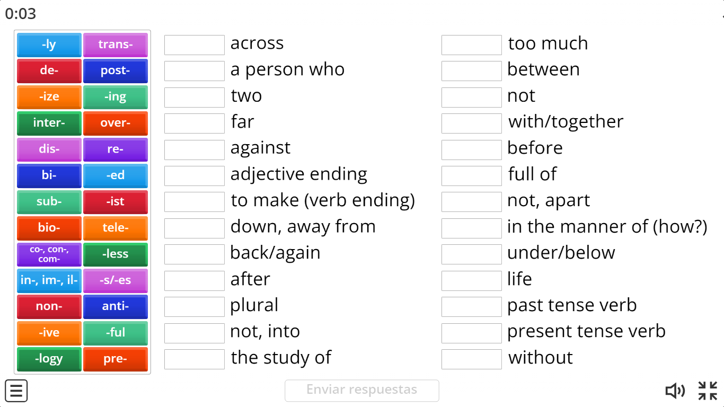
Practice 1ª: match the prefixes –suffixes to their
corresponding meaning
https://wordwall.net/es/resource/5281207/prefixes-and-suffixes
Notes:
Identify words that have prefixes and suffixes: https://docs.google.com/document/d/1zRDRXCCWAltDi3bqArSwWsT0ufKNP5m-/edit?usp=sharing&ouid=107132437745420382364&rtpof=true&sd=true
Reading:

Slide 17
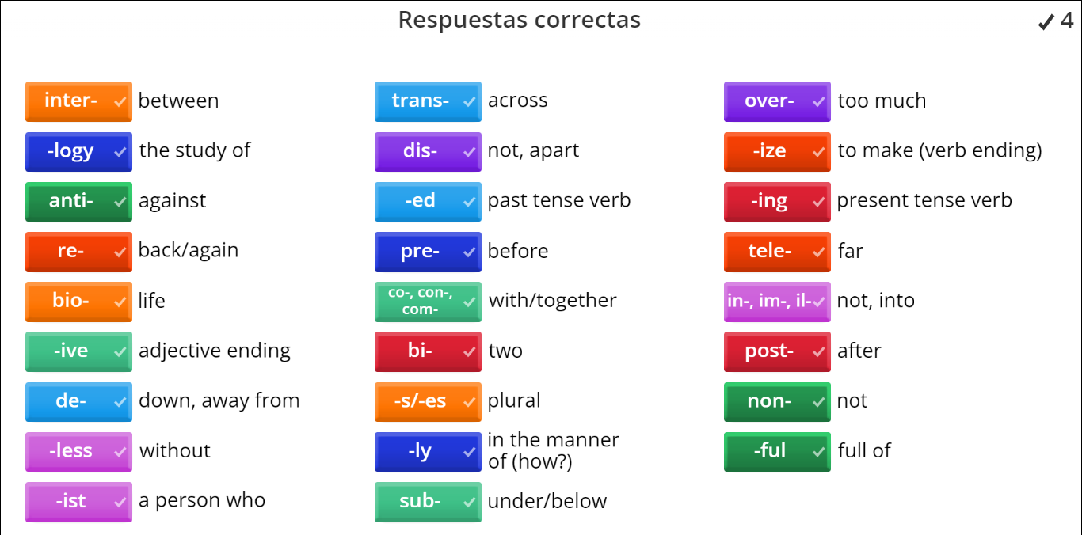
Practice 1ª- Answers
Notes:
Reading:

Slide 18
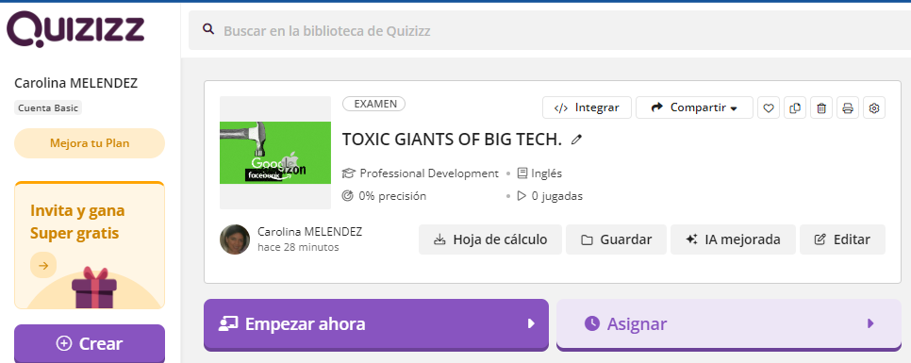
Practice 3: Reading Comprehension Activity
https://quizizz.com/admin/quiz/66394cdd31367ea41b5e33f7

Slide 19
Homework
Look at these FLASHCARDS about Prefixes & Suffixes.
https://quizlet.com/gt/606112903/prefixes-suffixes-flash-cards/?funnelUUID=9d3de1f9-9d9b-40c2-a089-18b0556ac876
Go to QUIZLET and create 10 flashcards: 5 with Prefixes & 5 with Suffixes.
You can use Definitions and Images.
Copy the link of your flashcards in a Word document.
Upload it to our Drive.
https://drive.google.com/drive/folders/1wu2C7PWIc8BTQAvKspbb7sU_aRW561ND

Slide 20
Practice 1B READING ACTIVITY
TOXIC GIANTS OF BIG TECH.
Kara Swisher, a veteran journalist and podcaster, has spent decades scrutinizing Silicon Valley and its prominent figures.
Initially optimistic about technology's potential to improve humanity, she now believes that greed and ego have corrupted the industry. Her memoir, "Burn Book," explores her experiences with tech giants like Bill Gates, Steve Jobs, Mark Zuckerberg, Jeff Bezos, Elon Musk, and the Google founders, offering insightful and sometimes scathing portrayals.
Swisher criticizes tech leaders for prioritizing profit over principles, particularly highlighting their cozy relationship with Trump despite knowing his harmful policies. She believes that figures like Zuckerberg and Musk are incapable to handle the immense power they wield, evidenced by their questionable decisions and lack of accountability. Her disappointment with Musk is particularly pronounced, as she once saw him as a promising innovator but now views him as self-destructive and erratic. Despite their financial power, she doubts their long-term sustainability, especially considering their controversial actions and attitudes.
Notes:
Identify words that have prefixes and suffixes: https://docs.google.com/document/d/1zRDRXCCWAltDi3bqArSwWsT0ufKNP5m-/edit?usp=sharing&ouid=107132437745420382364&rtpof=true&sd=true
Reading:

Slide 21
Practice 1B READING ACTIVITY
Swisher remains hopeful about the American people's ability to reject leaders like Trump, emphasizing the importance of decency and accountability in governance. She expresses a desire to see Trump held accountable for his actions, even suggesting that he deserves imprisonment. Overall, Swisher's perspective offers a critical examination of Silicon Valley's culture and its impact on society, emphasizing the need for ethical leadership and responsible technology development.
Notes:
Identify words that have prefixes and suffixes: https://docs.google.com/document/d/1zRDRXCCWAltDi3bqArSwWsT0ufKNP5m-/edit?usp=sharing&ouid=107132437745420382364&rtpof=true&sd=true
Reading:

Slide 22
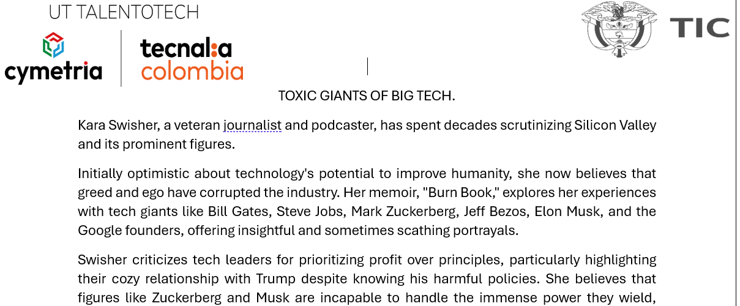
Practice 2: Underline the words that contain prefixes and suffixes.
Notes:
Identify words that have prefixes and suffixes: https://docs.google.com/document/d/1zRDRXCCWAltDi3bqArSwWsT0ufKNP5m-/edit?usp=sharing&ouid=107132437745420382364&rtpof=true&sd=true
Reading:

Slide 23


